Slide 1
Training Neural Nets with Back Propagation to Control Xpilot Agents
Researcher: Skylar Levey, 2019
Advisor: Gary Parker

Slide 2
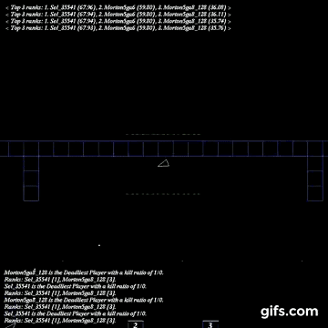
What is Xpilot/Xpilot-AI
Open-source two-dimensional space combat simulator.
Simple controls - thrust, turn and shoot.
Xpilot-AI is a platform that was developed to test AI
learning systems.
Allows researchers access to information about the
environment such as position, enemy position, speed,
heading.
This information is updated every frame of gameplay to allow actual real time control of an agent.

Slide 3
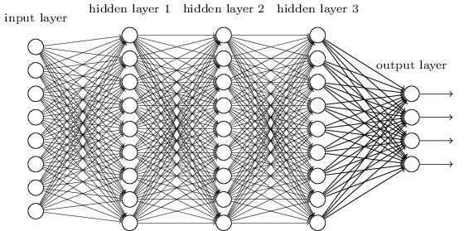
Introduction
My goal was to test the effectiveness of an Xpilot agent that is controlled by a neural net whose weights are learned through the use of back propagation.
There have been agents controlled by genetic algorithms, neural nets taught by genetic algorithms (like on the last slide), fuzzy logic systems, and rule based systems.
However, a neural net taught with back propagation had never been tested. This is due to the fact that back propagation requires something to observe, which is not always easy to find.

Slide 4
How do Neural Nets Work
.7
.5
Neural nets are essentially just complex pattern recognizers.
They are made up of several rows of nodes with weights connecting them.
An input is fed into one side, computations are done, and then an output comes out of the other side.
The hidden layers allow for complex inputs to be subtly
distinguished from other similar inputs.
.2
.25
.4
.5
.5
1.2
.5
2
.25
.5
.5
.33
.4
.8
.3

Slide 5
How does Backpropagation work?
1? 0?
For each node, calculate how much of an impact it had on the error.
With this error make small adjustments to the weights so that next time the neural net comes across the same inputs, it is more likely to get closer to the correct output.
.3
.7
.5
.5
.2
.25
.4
.5
.5
1.2
.5
2
.25
.5
.5
.33
.4
.8
.3

Slide 6
What I did
Wall Feelers
Xpilot runs at 10-20 fps (frames per second)
During each frame:
Observe the bot’s position and what it did
Feed these inputs into the neural net to see what it would decide to do if it was in the same situation.
Compare my agent’s output to what the observed agent did in that frame and propagate the error back through the NN to train it.
Repeat, a lot of times (a few million).
Tracking (direction agent is going)

Slide 7
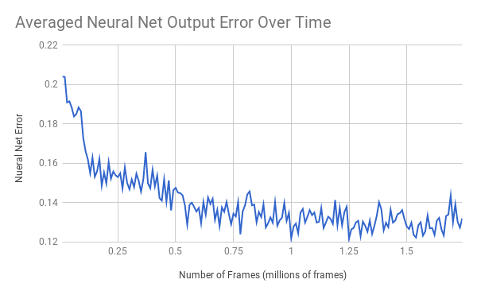
Results (Last Semester)
Error formula = ∑ .5*(output - desired)²

Slide 8
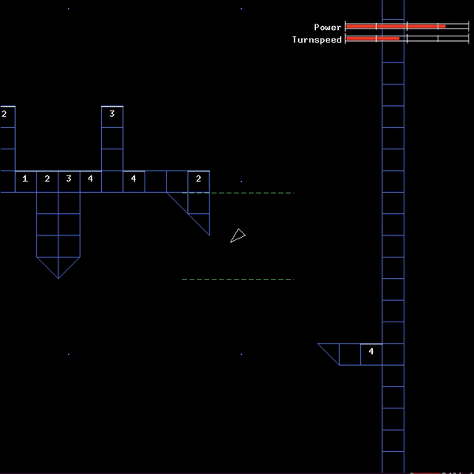
This Semester
Shifted the goal of the project away from the quantitative error
calculation toward more qualitative performance-based evaluation
(see how well we can teach the learned agent to drive).
We did this by:
-Removing enemies and shooting altogether.
-Simplifying the neural net to allow it to learn more efficiently.
-Simplifying the teaching agent to match the new net architecture.
-Adding a behavior to the teaching agent so it actively stays as far
away from walls as possible instead of just thrusting when it needed to.
-Other smaller tweeks.
Overall, work became more experimental and focused on finding the
proper set of inputs which keep the net simple yet effective.

Slide 9
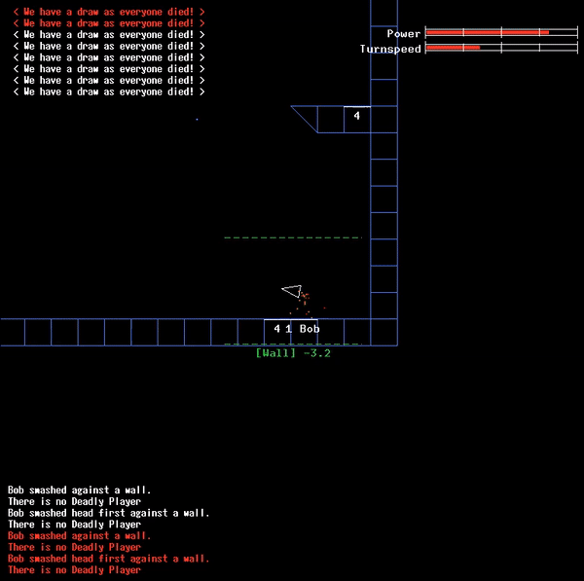
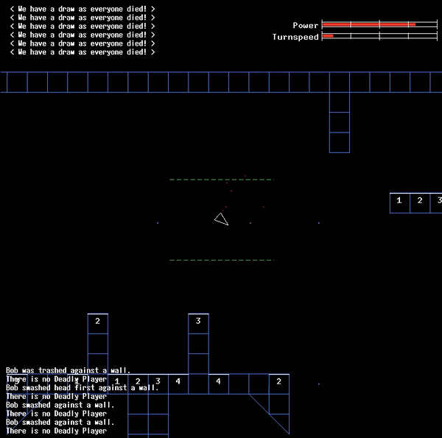
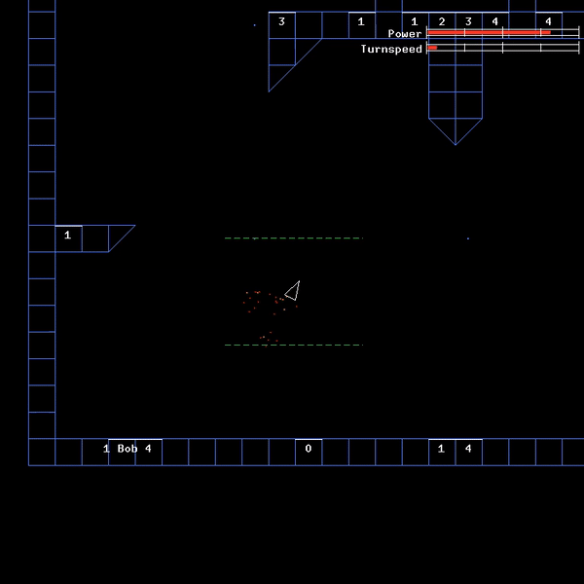
Results (This semester)
Completely Random NN
After ~27,000 frames of learning
After ~81,000 frames of learning
Notes:
As seen in the graph the error doesn’t improve that much after a while, but it does keep improving where it counts, so that thrust value gets better when it gets close to walls which makes a huge difference

Slide 10
Further Research
The first expansion that comes to mind is adding back the combat component. This increases the complexity almost exponentially as now the net must learn to keep track of, and shoot at, an enemy in addition to avoiding walls, which is hard as is.
Secondly, an interesting direction the project could be taken in would be for someone to use a different approach, possibly a Genetic Algorithm with a neural net, to find an optimal set of inputs under which the neural net can learn.

Slide 11
Thanks!
Questions?

